Slide 1
used cars price prediction price in Saudi Arabia regression models
Presented by/ Jamilah Rabeh
Supervised by/Dr.mejdel Alqahtani

Slide 2
Abstract
Our project aimed to applied regression model to predict price of the used cars in Saudi Arabia
This project may help people to have a clear vision about use car prices and what the main factors that has a higher influence
I used web scraping to obtain data from syarah web site (web scraping and selenium)
I applied nonlinear regression (polynomial regression)
I applied four models to reach to the best score of error

Slide 3
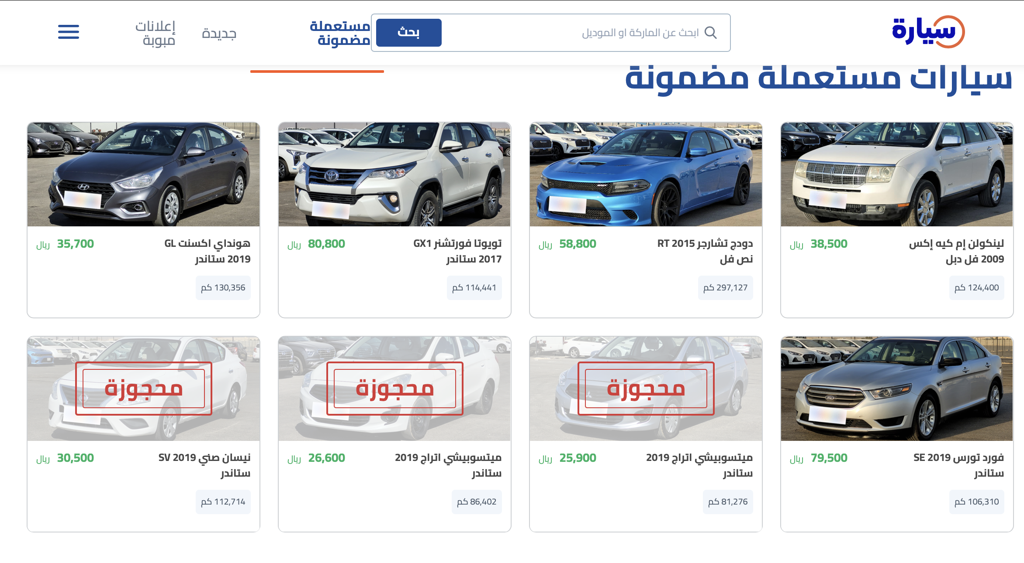
Data
Features
Car name
Model
Mileage
Engine size
Options
Fuel type
Regions
Origin
color
price
DS=8765X10

Slide 4
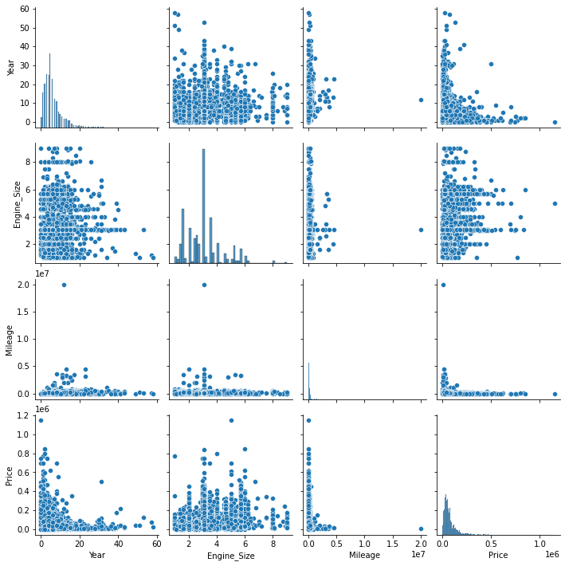
EDA
visualized distribution and correlation of features
handling missing values and outlier
IQR
skewness value of Price: 3.6917 after 0.8908
skewness value of Mileage: 39.755 after 0.97886
skewness value of Engine Size: 1.0074
detect multicollinearity by Variance Inflation Factor
feature VIF
Year 2.841255
Mileage 2.815823
Engine_Size 2.741316
Generated ‘car age column’ and ‘fuel economy’
Label encoding for categorical columns
Std scaling

Slide 5
Model 1
Model 2
Polynomial feature D=2 , column= 263 ,alph=0.1
Polynomial feature D=3, column= 3654 ,alph=0.2
R^2 train
R^2
test
R^2 train
R^2
test
Linear reg
0.54
0.34
Linear reg
0.64
0.60
lasso
0.58
0.56
lasso
0.76
0.69
Ridge
0.60
0.59
Ridge
0.75
0.71
Required column=207
Required column=501

Slide 6
Model 3
Model 3
Polynomial feature D=3 , column= 3654
Polynomial feature D=4 , column= 27405
R^2 train
R^2
test
R^2 train
R^2
test
Linear reg
0.64
0.45
Linear reg
0.74
0.62
lassoCV
0.78
0.67
lassoCV
0.81
0.78
RidgeCV
0.78
0.72
RidgeCV
0.85
0.83
Required column=645
Required column=645

Slide 7
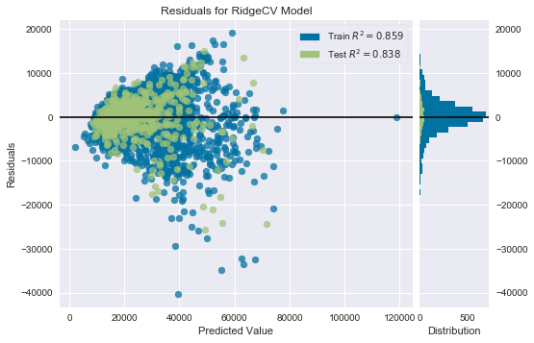
model performance

Slide 8
Conclousion
The model has a good fitting for inexpensive cars
Extract importance feature and retrain model has a good impact on rising R squre
Using LasooCV or RidgeCV may work efficiently rather than tunig hyper parameter by your self
RidgeCV was the best model prediction

Slide 9
Future work
Tunig more hyper prameters
Using Random forcement
Creating more features from esxited features

